Slide 1
EXAMINATION SYSTEM

Slide 2

AGENDA
Who We Are?
Introduction.
Tools.
ERD.
Database Diagram.
SSIS
Insights
Demos.

Slide 3
WHO WE ARE?
Mohamed Saeed
Radwa Yasser
Osama Badr
Nada Mohamed

Slide 4
INTRODUCTION
Fully automated examination system to
perform online exams by ITI instructors
and students, build SQL databases, and analyze it then create dashboard
and reports having clear insights.

Slide 5
TOOLS
ERD Plus.
SQL server.
SSIS.
SSRS.
Red Gate Data Generator.
C#.
Power BI.

Slide 6
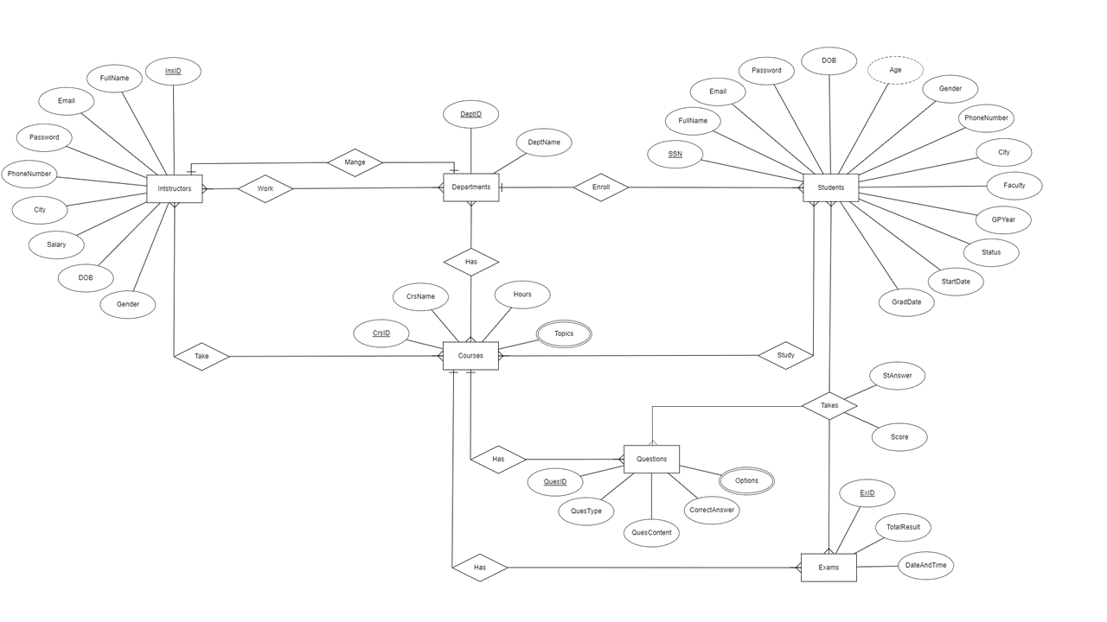
ERD

Slide 7
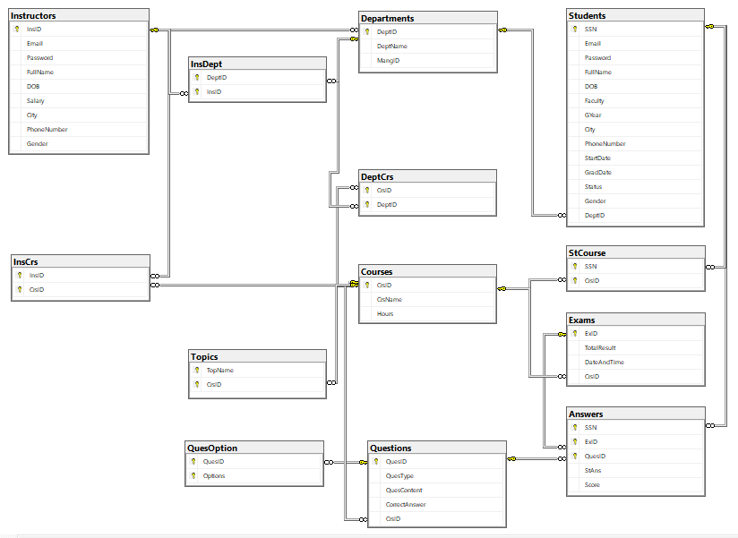
DATABASE DIAGRAM

Slide 8
SSIS RED GATE STORED PROCEDURES SSRS

Slide 9
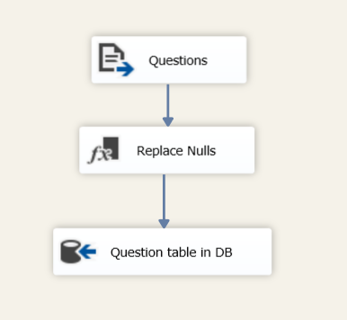
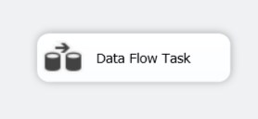
SSIS

Slide 10
INSIGHTS
Ratio/Number of students in each department.
Average score for each subject.
The number of students from each City.
The number of students from each Faculty.
The percentage of each college in each track.
Courses duration distribution .
The number of students for the year of their graduation.

Slide 11
DEMOS

Slide 12
THANKS!

Slide 13
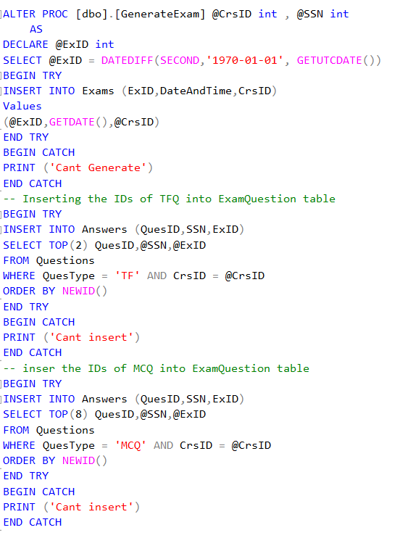
EXAM CREATION

Slide 14
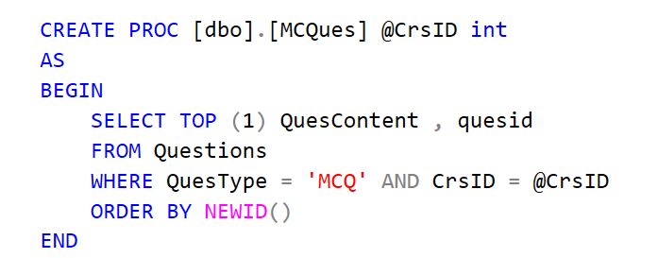
SELECT MCQ Ques

Slide 15
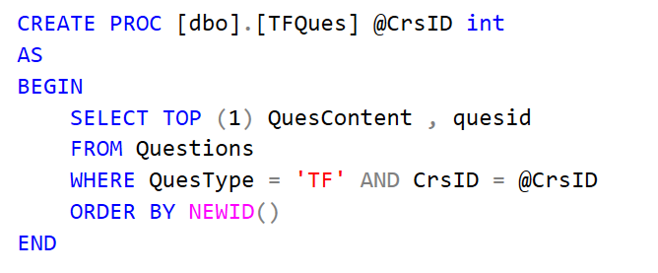
SELECT TF Ques

Slide 16
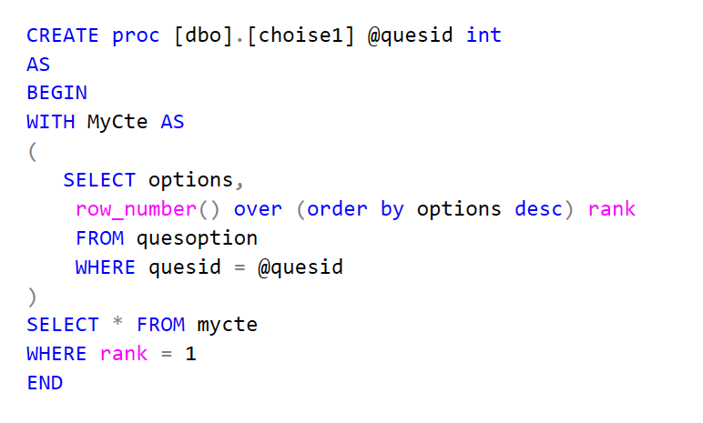
SELECT Choice

Slide 17
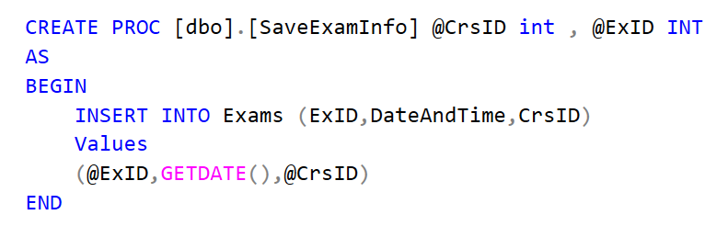
SAVE EXAM INFO

Slide 18
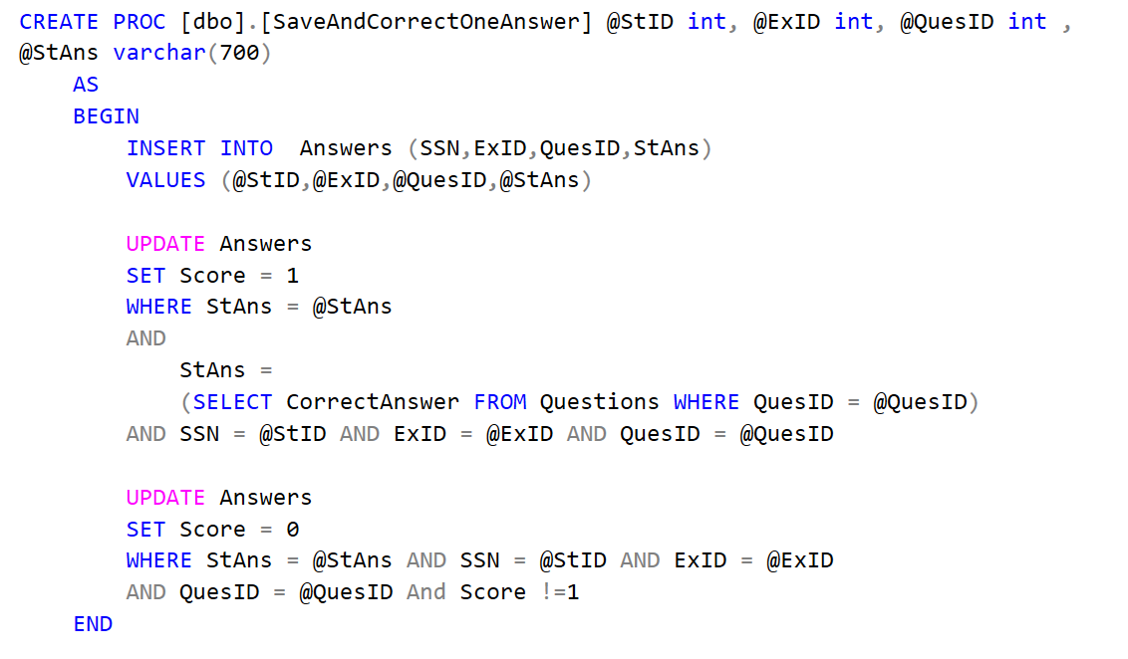
SAVE & CORRECT EXAM

Slide 19
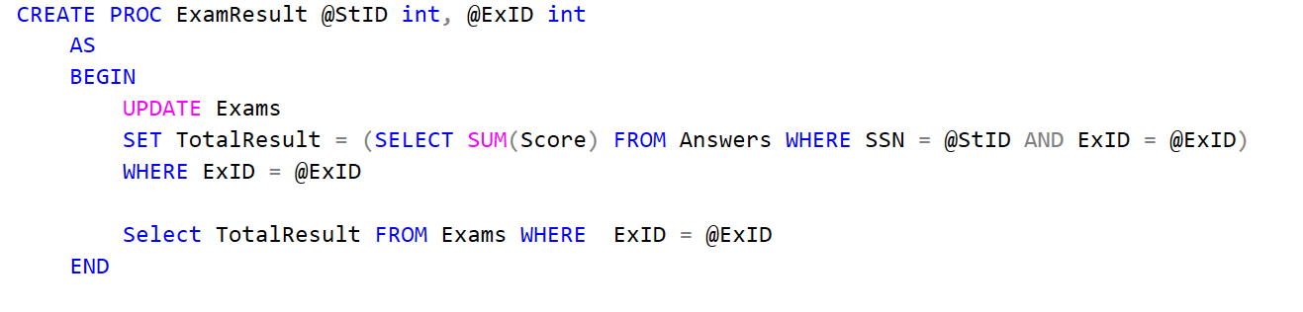
RESULTS

